Slide 1




Slide 2



Who we are and what we do
TEPEx - the regional leader in manufacturing of the explosion-protected electrical equipment
Our vision: continue the tradition of more than 60 years of experience in the field
1948.
2002.

Slide 3
Who we are and what we do
In accordance with national regulative, all of our products and systems for quality assurance are certified by an authorized certification institution according to the ATEX Directive 94/9/EC by an authorized certification notify body.
Ex AGENCIJA, NB/2465 - Croatia
CESI, NB/0722 - Italy
Quality Assurance System ISO 9001:2009
Environmental Management System ISO 14001:2010
EAC certifikat / Eurasian Customs Union
(Russia, Belarus, Kazakhstan, Armenia, Kyrgyzstan)

Slide 4
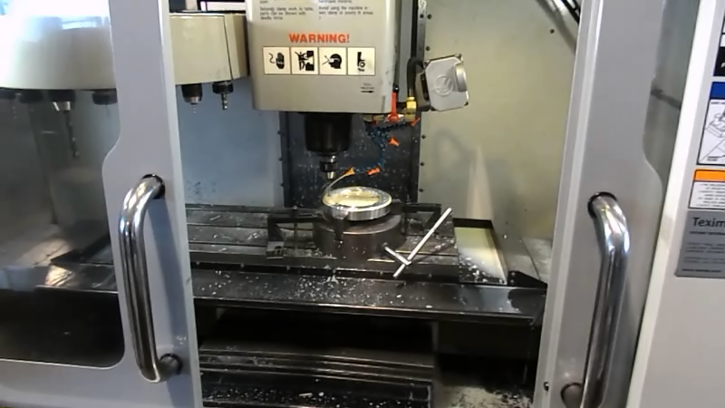
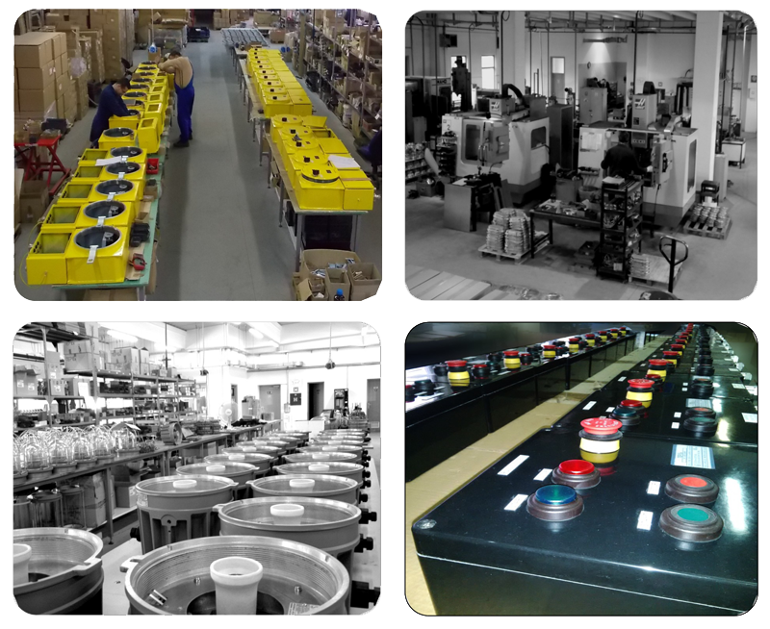
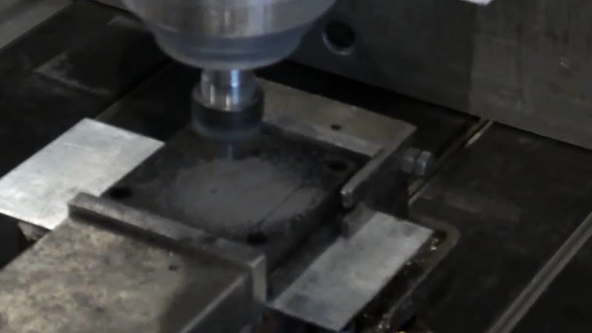
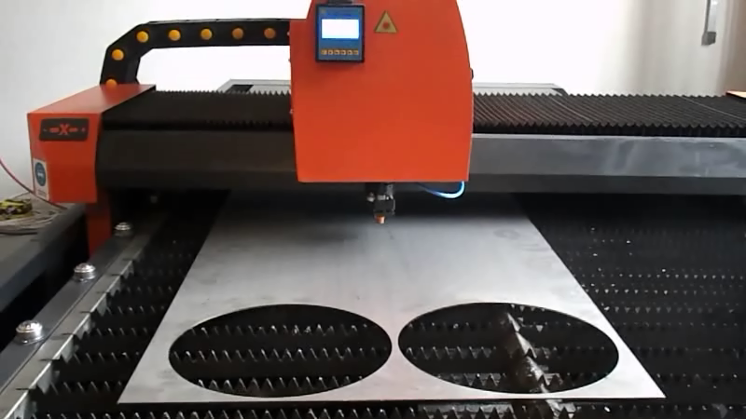
Production of
Ex electrical equipment
CNC machines
CNC drilling
2500 M²
Laser machines

Slide 5
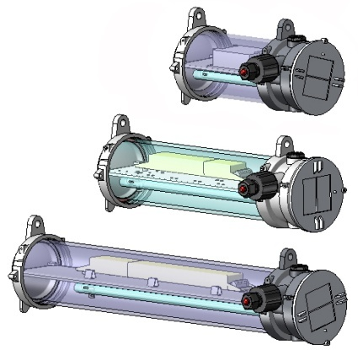
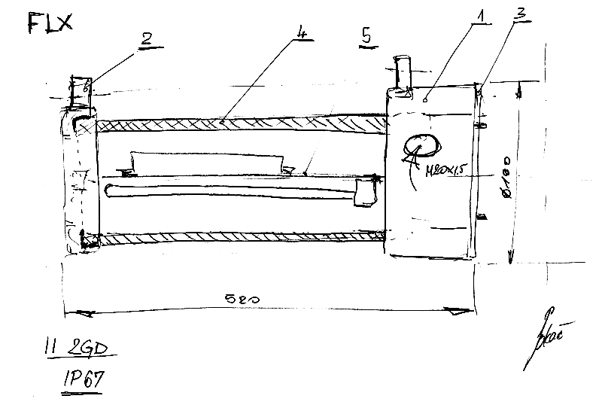
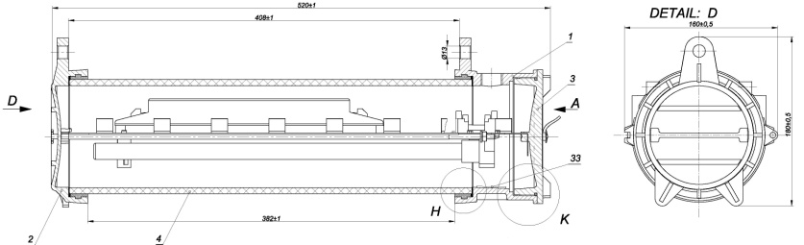
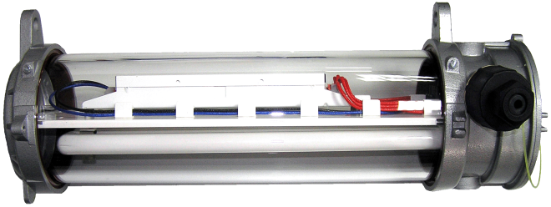
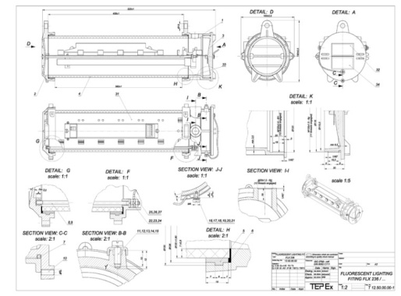
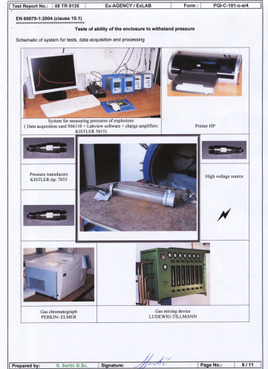
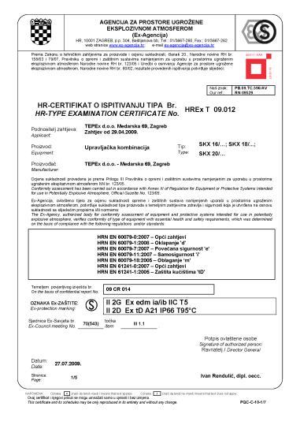
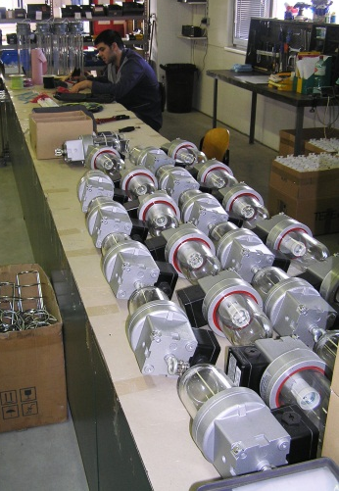

Concept
3D design
Technical documentation
Certification documentation
Prototype
Testing
Certification
Production

Slide 6
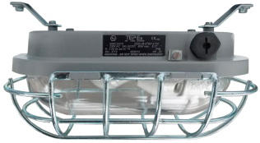
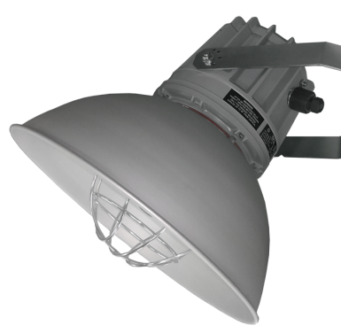
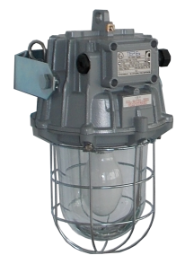
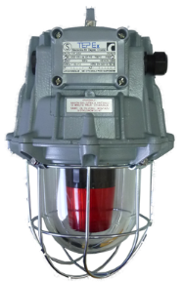
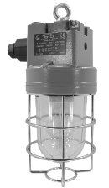
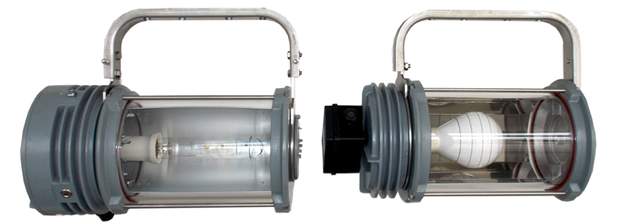
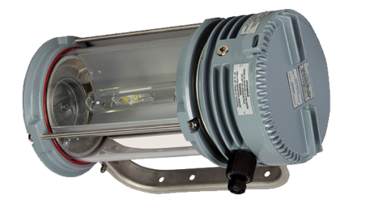
MAIN PRODUCTS GROUPS
Bulkhead light fittings
Pendant light fittings
Floodlights

Slide 7
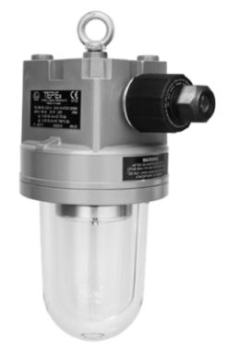

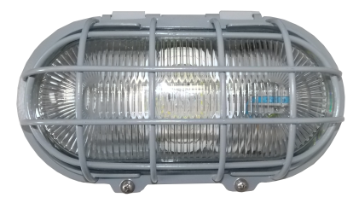
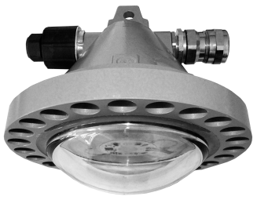
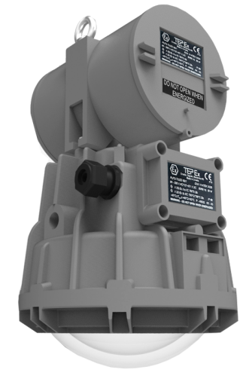
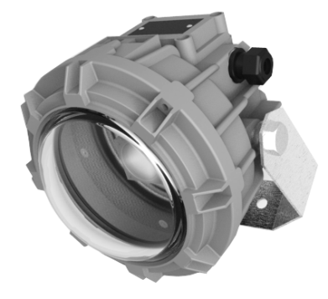
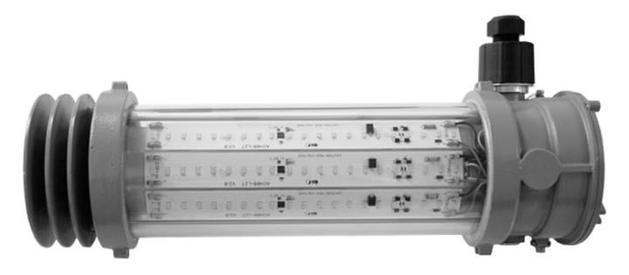
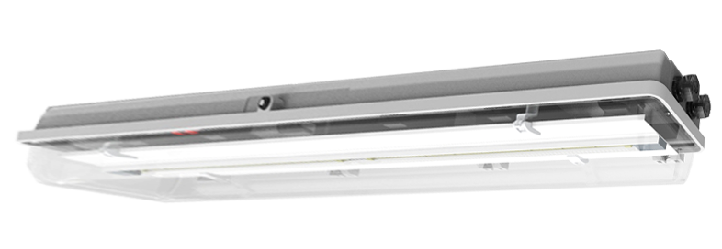
MAIN PRODUCTS GROUPS
20W
30W
35W
60W
80W
LED light fitting
3x12W
26W
48 W

Slide 8
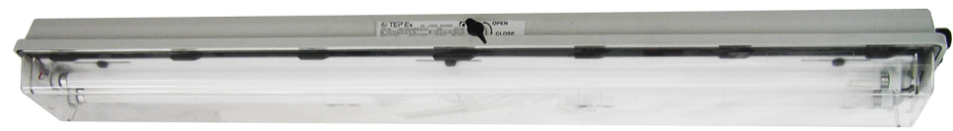
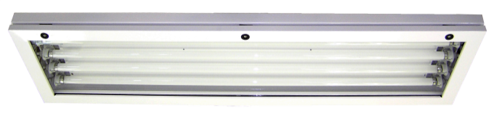
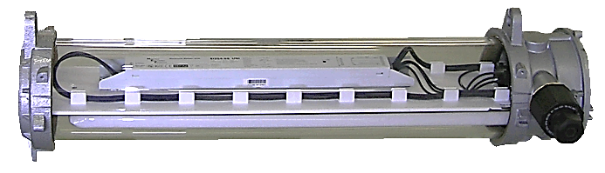
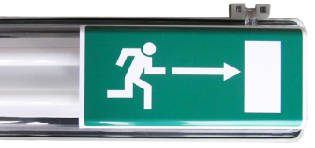
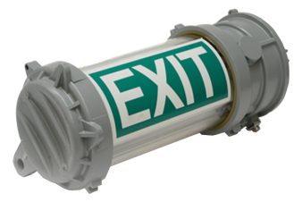
MAIN PRODUCTS GROUPS
T8 fluo tube
GRP
METAL
Fluorescent
light fittings
TC-L compact
Al + glass
T8 emergency
LED emergency

Slide 9
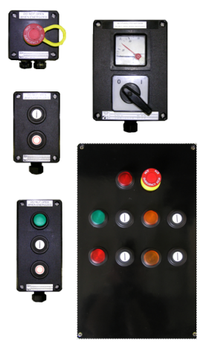
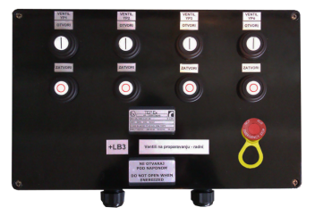
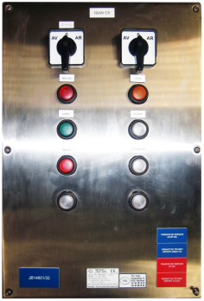
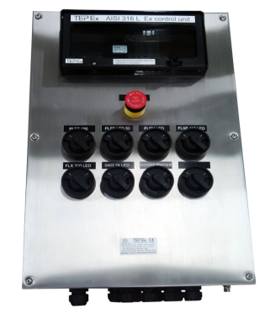
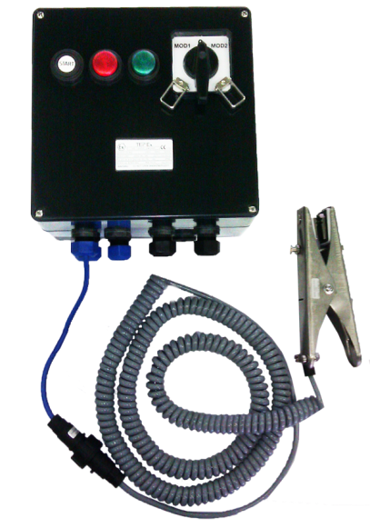
MAIN PRODUCTS GROUPS
GRP
Control units
SS AISI 316L
Grounding
control device

Slide 10
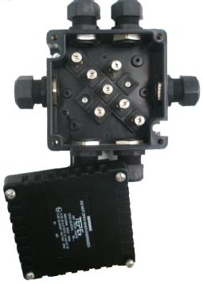
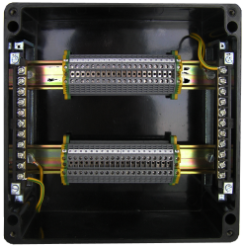
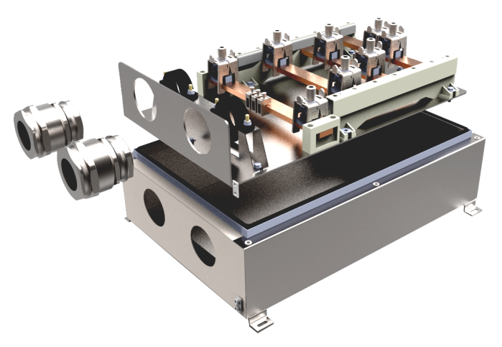
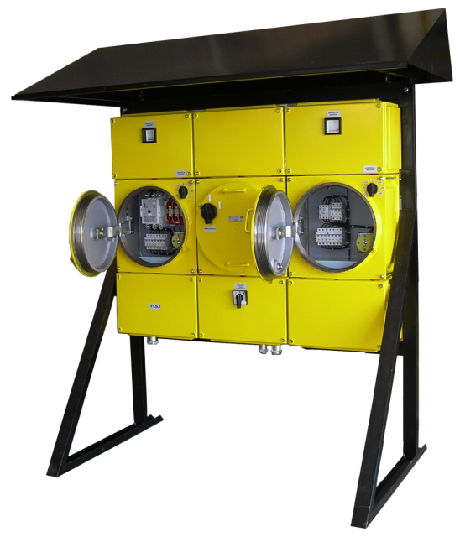
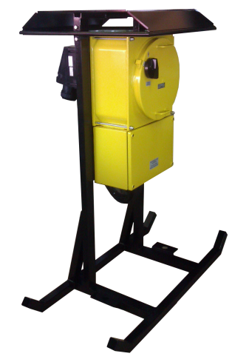
MAIN PRODUCTS GROUPS
Terminal boxes
Busbar enclosures
Distribution cabinets

Slide 11
BULKHED LIGHT FITTINGS
PENDANT LIGHT FITTINGS
FLOODLIGHTS

Slide 12
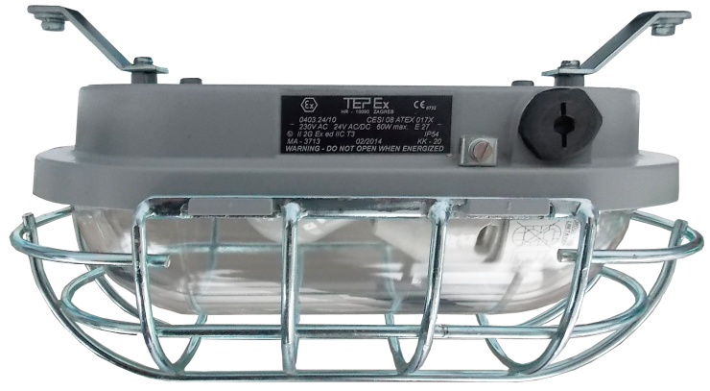
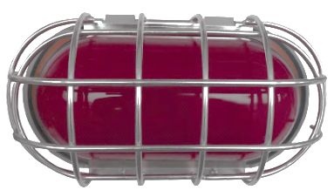
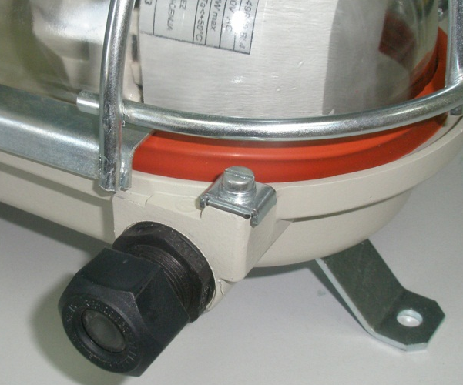
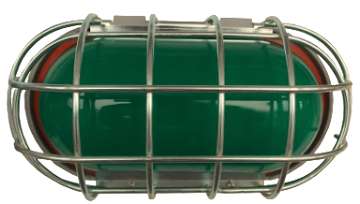
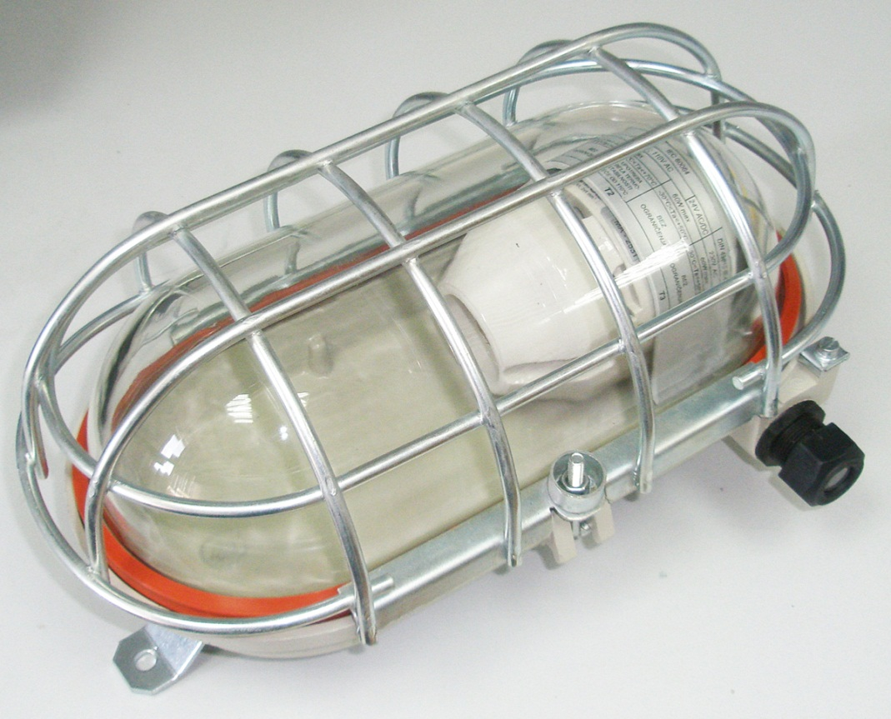
Ex bulkhead light fitting
0403.24/..
Apparatus category: | II 2G , I M2
Explosion protection: | Ex ed I/IIC T2/T3
Enviroment temperature: | -30°C ÷ +40/60°C
Degree of protection: | IP64
Rated voltage. | 250V ±10% AC 24V ±10% AC
Max. wattage | 100W, A/QT, 1800lm

Slide 13
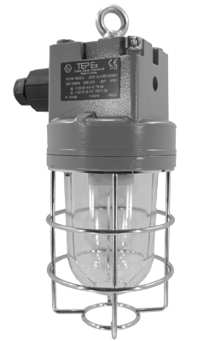
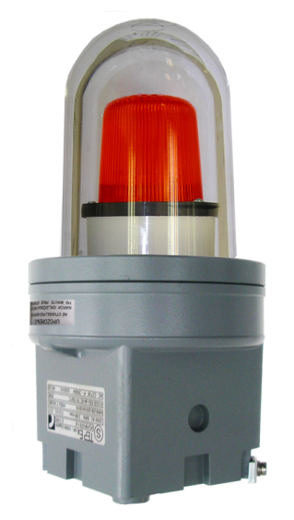
Ex pendant light fitting
PLFM
Apparatus category: | II 2GD
Explosion protection: | Ex de IIC T6-T3 Gb Ex d IIC T6-T3 Gb Ex tb IIIC T80°C /155°C Db
Enviroment temperature: | -20°C ÷ +40°C
Degree of protection: | IP66
Rated voltage: | 230V ±10% AC FLASH 24V, 110V, 230V
WATTAGE | TYPE | LUMINOUS FLUX
100 W | A, QT, A ECO | 1500 lm ÷ 2100 lm
23 W | TC-SB | 1500 lm
20 W | LED | 1300 lm
70 W | HSE | 5900 lm

Slide 14
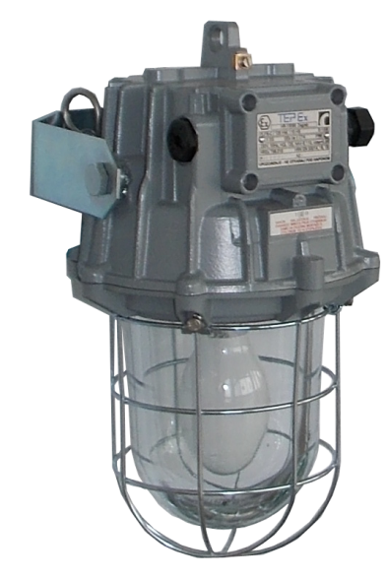
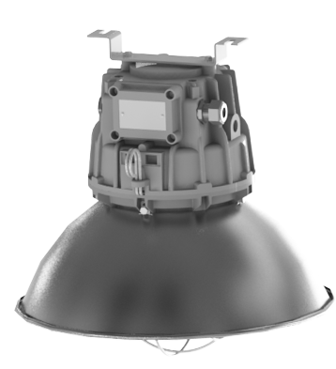
Ex pendant light fitting
PLFS
Apparatus category: | II 2GD
Explosion protection: | Ex de IIC T6-T4 Ex tD A21 T80°C /130°C
Enviroment temperature: | -20°C ÷ +40/50°C
Degree of protection: | IP66/67
Rated voltage: | 230V ±10% AC FLASH 24V, 110V, 230V
WATTAGE | TYPE | LUMINOUS FLUX
230 W | A, QT | 4200 lm
125 W | HME | 6700 lm
100 W | HSE | 9000 lm
150 W | HIE | 12 500 lm

Slide 15


Ex pendant light fitting
PLFL
Apparatus category: | II 2GD
Explosion protection: | Ex de IIC T4-T3 Gb Ex tb IIIC T140°C /150°C Db
Enviroment temperature: | -40°C ÷ +50°C
Degree of protection: | IP66
Rated voltage: | 230V ±10% AC
WATTAGE | TYPE | LUMINOUS FLUX
250 W | HIE HSE HME | 20 000 lm 28 000 lm 20 000 lm
500 W | A QT | 8400 lm 10 250 lm

Slide 16
Ex floodlight
RLF
Apparatus category: | II 2GD
Explosion protection: | Ex de IIC T4-T3 Gb Ex tb IIIC T190°C /130°C Db
Enviroment temperature: | -20°C ÷ +40°C
Degree of protection: | IP66
Rated voltage: | 230V ±10% AC RLF QL 200-277V / 190-264VDC
WATTAGE | TYPE | LUMINOUS FLUX
400 W | HIT HST HME | 34 000 lm 56 500 lm 22 000 lm
500 W | QT | 6300 lm
85 W 165 W | QL QL | 6300 lm 12 000 lm

Slide 17

Ex LED light fittings
LED sources in TEPEx light fittings
TYPE | WATTAGE | lm/W
PLFS 50 LED | 30 W (Bridgelux + MW) | 160 lm/W
 | 50W (Bridgelux + MW) | 160 lm/W
 | 85W, 60W (Citizen + MW) | 170 lm/W
PLFM 20 LED | 20 W (Seoul Semiconductor) | 100 lm/W
0403.24 LED | 20 W (Seoul Semiconductor) | 100 lm/W
FLX 310 LED | 3x12 W( Seoul Semiconductor) | 100 lm/W
The given information is for rough orientation only. In each individual case a lighting calculation is necessary.

Slide 18


Ex LED bulkhead light fitting
0403.24 LED
Apparatus category: | II 2GD
Explosion protection: | Ex ed mb IIC T6 Gb Ex tb IIIC T80°C Db
Enviroment temperature: | -30°C ÷ +60°C
Degree of protection: | IP66
Rated voltage: | 230V ±10% AC
WATTAGE | TYPE | LUMINOUS FLUX
20 W | LED | 2000 lm

Slide 19




Ex LED pendant light fitting
PLFM LED
Apparatus category: | II 2GD
Explosion protection: | Ex d e IIC T6 Gb Ex tb IIIC T80°C Db
Enviroment temperature: | -20°C ÷ +60°C
Degree of protection: | IP66
Rated voltage: | 230V ±10% AC
WATTAGE | TYPE | LUMINOUS FLUX
20 W | LED | 2000 lm
13 W | E27 LED | 1100 lm

Slide 20







Ex LED pendant light fitting
0401.35 LED 30
Apparatus category: | II 2GD
Explosion protection: | Ex e mb IIC T6 Gb Ex tb IIIC T80°C Db
Enviroment temperature: | -20°C ÷ +40°C
Degree of protection: | IP66
Rated voltage: | 230V ±10% AC
WATTAGE | TYPE | LUMINOUS FLUX
30 W | LED | 3000 lm

Slide 21





Ex LED pendant light fitting
PLFS LED 50
Apparatus category: | II 2GD
Explosion protection: | Ex d e IIC T6 Gb Ex tb IIIC T80°C Db
Enviroment temperature: | -40°C ÷ +50°C
Degree of protection: | IP66
Rated voltage: | 90-305 VAC 127-431 VDC
Recessed mounting
WATTAGE | TYPE | LUMINOUS FLUX
35 W | LED | 5 950 lm
50 W |  | 8 500 lm
60 W |  | 10 200 lm
85 W |  | 13 600 lm

Slide 22




Ex LED linear light fitting
FLX 310 LED
Apparatus category: | II 2GD
Explosion protection: | Ex d e IIC T6 Gb Ex tb IIIC T80°C Db
Enviroment temperature: | -20°C ÷ +50°C
Degree of protection: | IP66
Rated voltage: | 220-240 V
WATTAGE | TYPE | LUMINOUS FLUX
3x12 W | LED | 3600 lm

Slide 23


Ex LED linear light fitting
PSF LED
Apparatus category: | II 2GD
Explosion protection: | Ex db eb mb IIC T4 Gb Ex tb IIIC T80°C Db
Enviroment temperature: | -20°C ÷ +55°C
Degree of protection: | IP66
Rated voltage: | 110-240 VAC 220-250 VDC
TYPE | LED power | Luminous flux [lm] of LED source | η
PSF 28 LED | 26 W | 4000 lm | 0,85
PSF 52 LED | 48 W | 6300 lm
TYPE | L1 [mm] | L2 [mm]
PSF 28 LED | 750 | 400
PSF 52 LED | 1370 | 800

Slide 24
Ex fluorescent light fittings

Slide 25






Ex fluorescent light fitting
PSF
Apparatus category: | II 2GD
Explosion protection: | Ex d e mb IIC T4 Gb Ex tb IIIC T80°C Db
Enviroment temperature: | -20°C ÷ +50°C
Degree of protection: | IP66
Rated voltage: | 220-240 V
WATTAGE | TYPE | LUMINOUS FLUX
2x18 W | T8/G13 | 2700 lm
2x36 W |  | 6700 lm
2x58 W |  | 10 400

Slide 26




Ex fluorescent light fitting
FLX
Apparatus category: | II 2GD
Explosion protection: | Ex d e IIC T5/T6 Ex tD A21 T95°C/T80°C
Enviroment temperature: | -20°C ÷ +50°C
Degree of protection: | IP66
Rated voltage: | 100÷280 V AC/DC
WATTAGE | TYPE | LUMINOUS FLUX
2x18 W | TC-TSE/2G11 | 2400 lm
2x36 W | TC-TSE/2G11 | 5800 lm
2x55 W | TC-TSE/2G11 | 9400 lm

Slide 27


Ex fluorescent light fitting
SIF
Apparatus category: | II 2GD
Explosion protection: | Ex d e mb IIC T4 Gb Ex tb IIIC T80°C Db
Enviroment temperature: | -30°C ÷ +50°C
Degree of protection: | IP66
Rated voltage: | 220-240 V
Recessed mounting
MAX. WATTAGE | TYPE | LUMINOUS FLUX
2x36 W | T8/G13 | 6700 lm
4x36 W | T8/G13 | 13 400 lm

Slide 28








Ex emergency LED light fitting
FLXE 118 LED
Apparatus category: | II 2GD
Explosion protection: | Ex d e IIC T6 Gb Ex tb IIIC T80°C Db
Enviroment temperature: | -20°C ÷ +50°C
Degree of protection: | IP66
Rated voltage: | 24, 60, 110-127 VAC/DC 220-240 VAC/DC
Rated autonomy: | > 3 hours
Battery: | Ni-MH 3,6V/2.2Ah
330
220
240
160
180
WATTAGE | TYPE | LUMINOUS FLUX
2x 1.2 W | LED | 200 lm

Slide 29

Ex emergency light fitting
PSF E
Apparatus category: | II 2GD
Explosion protection: | Ex d e mb IIC T4 Gb Ex tb IIIC T80°C Db
Enviroment temperature: | -20°C ÷ +40°C
Degree of protection: | IP66
Rated voltage: | 220-240 V
Rated autonomy: | 1,5h or 3h
Battery: | Ni-Mh Saft VHT D, 4,8V 6Ah Ni-Mh Saft VHT F, 4,8V 10Ah
WATTAGE | TYPE | LUMINOUS FLUX | Baterry mod [lm]
2x18 W | T8/G13 | 2700 lm | 3h 550 lm 1,5h 800 lm
2x36 W | T8/G13 | 6700 lm | 3h 1000 lm 1,5h 2000 lm

Slide 30
Ex control units
SKX 12 .... SKX 20

Slide 31

Ex control units
SKX 12 .... SKX 20
Apparatus category: | II 2GD
Explosion protection: | Ex de mb IIC , Ex ia/ib IIC T6 Gb Ex tb IIIC T80°C Db
Enviroment temperature: | -20°C ÷ +50°C
Degree of protection: | IP66
Rated insulation voltage: | 690 VAC
Rated current: | Up to 16A (SKX 12-15) Up to 80A (SKX 16-20)

Slide 32

Ex socket outlet boxes
Apparatus category: | II 2GD
Explosion protection: | Ex de IIC T6 Gb Ex tb IIIC T80°C Db
Enviroment temperature: | -20°C ÷ +50°C
Degree of protection: | IP66
Rated insulation voltage: | 690 VAC
Buildin sockets
* 16 A extra-low voltage, 2P/3P
* 16 A, 3P, 4P, 5P
* 32 A, 63 A, 4P,5P

Slide 33




Ex control unit
SKX SS AISI 316L
Apparatus category: | II 2GD
Explosion protection: | Ex de mb IIC , Ex ia/ib IIC T6 Gb Ex tb IIIC T80°C Db
Enviroment temperature: | -20°C ÷ +50°C
Degree of protection: | IP66
Rated insulation voltage: | 690 VAC
Hinged door
Components mounted on the cover

Slide 34




Ex grounding and grounding control device
GGCD-01/
Apparatus category: | II 2G
Explosion protection: | Ex de [ib] mb IIC T5 Gb
Enviroment temperature: | -20°C ÷ +50°C
Degree of protection: | IP66
Rated voltage: | 230 V ±10%
Rated current: | 50 mA

Slide 35
Ex junction boxes
Ex terminal boxes

Slide 36







Ex junction box
RK 01/
Apparatus category: | II 2GD
Explosion protection: | Ex e IIC , Ex ia/ib IIC T6 Ex tD A21 T80°C
Enviroment temperature: | -40°C ÷ +50°C
Degree of protection: | IP66
Rated insulation voltage: | 630 VAC

Slide 37



Ex d junction box
JBX
Apparatus category: | II 2GD
Explosion protection: | Ex d IIC Gb Ex tb IIIC Db
Enviroment temperature: | -20°C ÷ +60°C
Degree of protection: | IP66

Slide 38





Ex terminal boxes
SKX 12/E ..... SKX 20/E
Apparatus category: | II 2GD
Explosion protection: | Ex e IIC , Ex ia/ib IIC T6 Ex tD A21 T80°C
Enviroment temperature: | -20°C ÷ +50°C
Degree of protection: | IP66
Rated insulation voltage: | 750 VAC

Slide 39


Ex terminal boxes
SKX SS AISI 316L
Apparatus category: | II 2GD
Explosion protection: | Ex e IIC , Ex ia/ib IIC T6 Ex tD A21 T80°C
Enviroment temperature: | -40°C ÷ +50°C
Degree of protection: | IP66
Rated insulation voltage: | 750 VAC

Slide 40



Ex busbar enclosure
AISI 316L / SKX .....
Apparatus category: | II 2GD
Explosion protection: | Ex e IIC T6 Gb Ex tb IIC T80°C Db
Enviroment temperature: | -40°C ÷ +50°C
Degree of protection: | IP66
Rated insulation voltage: | 690 V

Slide 41
Ex distribution cabinets

Slide 42



Ex distribution cabinets
R3002 ..... R3006
Apparatus category: | II 2GD I M2
Explosion protection: | Ex de I/IIC T6 Mb Gb Ex tb IIC T80°C Db
Enviroment temperature: | -20°C ÷ +40°C
Degree of protection: | IP66
Rated current: | Up to 500 A
Terminal cross-section: | 240 mm²

Slide 43










Other Ex products and
Ex accessories
Ex adapter ADP
Ex multiwire bushing
type RSM
Ex electronic ballast
type SMP 07 (T8 fluo tube)
Ex connecting accessories
Ex cable glands, adaptors, plugs
Ex Torchlights

Slide 44






CERTIFICATES

Slide 45










GALLERY

Slide 46
Thank you for your attention

